Slide 1
Drone Collision Risk for Low Flying Manned Aircraft
A Case Study of a Documented Near Mid Air Collision

Slide 2
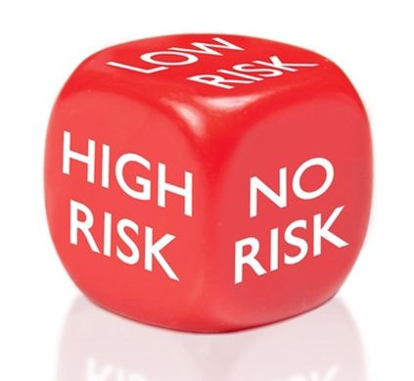
Drones Can Pose Real Risk to Helicopters
Did you know...
  There have been 7 confirmed collisions between drones and helicopters in the US since 2017*, each causing damage costing tens of thousands of dollars
    3 of the 7 collisions occurred below 400 feet Above Ground Level (AGL)
  A Chilean Navy helicopter collided with a 20 oz drone and it went thru the windscreen, severely injuring a front seat passenger
  There have been at least two probable collisions between a drone and a small General Aviation fixed wing aircraft in the US
*These data are current as of 22 December 2022
Notes:
Many people erroneously think that drones pose little to no risk to persons and property in the air and on the ground.
Key message: Documented collisions prove that drones do pose a significant risk to others
Key message: It is a false assumption to assume that you will not encounter a manned aircraft below 400’. Helicopters, ultralight vehicles, crop dusters, parasails, all regularly operate near the surface. Airspace is shared by many users.
If you fly near hospital helipads, be especially vigilant of low flying emergency medical service helicopters landing or departing from those helipads
If you operate near crops or open fields, look for low flying crop dusters.
Take extra precautions when flying near people. Drones flown by public safety are not certificated by the FAA, and often experience unexpected failures or loss of signal. Plan for the unexpected and consider the risks when you fly.
Encourage the audience to check out FAA Handbook FAA-H-8083-2A The Risk Management Handbook for some great ideas on how to manage risk

Slide 3
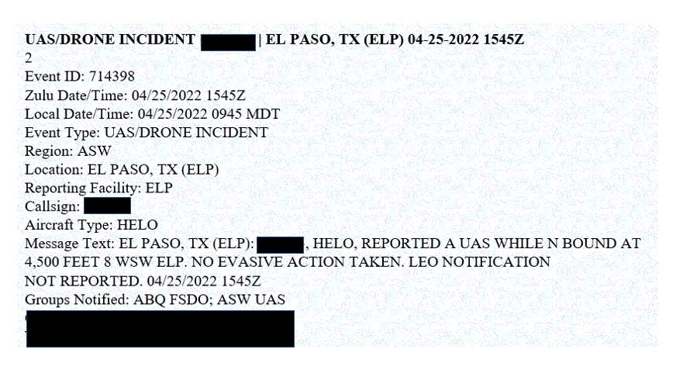
Let’s talk about a real near mid air collision...
NOTE: 4500 ft MSL is approximately 300 ft AGL at this location

Slide 4
Who, What, When, Where
9:45 am local, ~86° F, clear skies, visibility greater than 10 miles
  The Helicopter--AS350
    Single pilot
    Local EMS helicopter departed a local hospital to reposition to El Paso airport
    Due to high density altitude, helicopter was power limited
    The airport was nearby so the pilot stayed low
  The Drone--DJI Mini 2
    Drone Dimensions: 9.6” x 11.4” x 2.2”, (smaller than a Blue Jay)
    Drone Weight: 0.54 pounds
    Construction company doing work at a local high school hired a remote pilot to take pictures of work near tennis courts
    Remote Pilot parked car next to job site and set up to do a photoshoot without any assistance from others

Slide 5
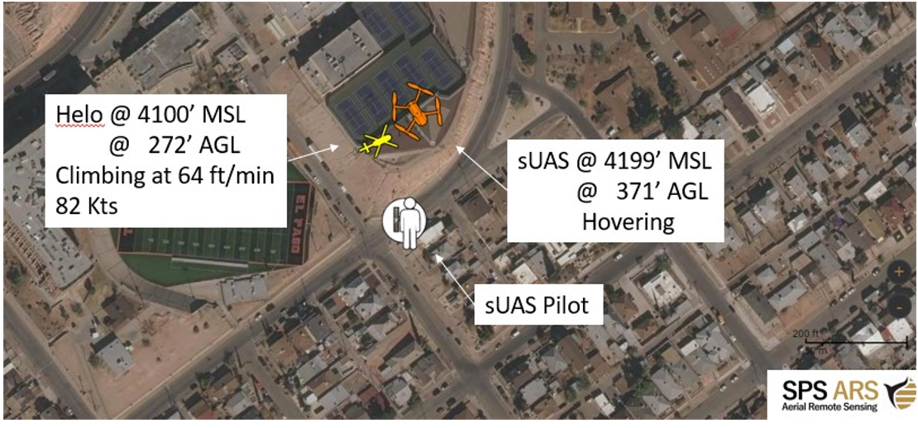
The Close Encounter
The drone was legal to be there and at that altitude
The drone pilot was facing away from helicopter and looking at his screen
The drone was above the helicopter and the helicopter pilot only saw it because it was silhouetted against a blue sky
Helicopter flew less than 100 feet UNDER the drone
Both pilots saw each other too late to maneuver

Slide 6
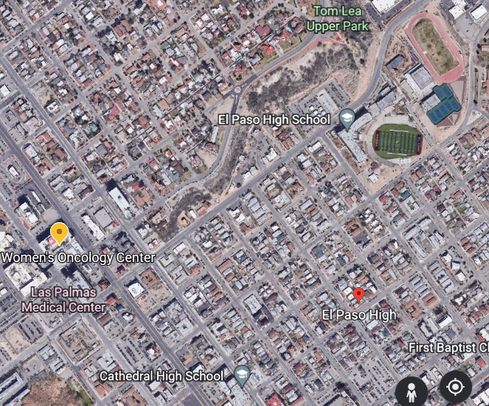
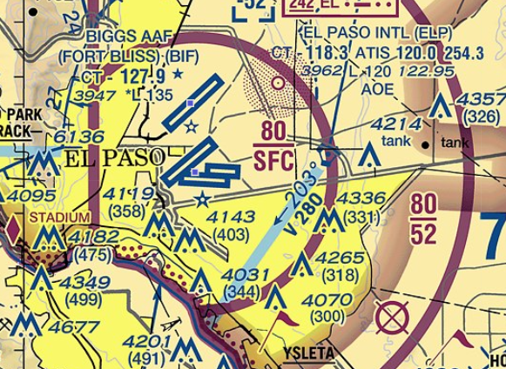

Approximate flight path of helicopter headed to ELP and location of Near Mid Air Collision (NMAC)
Class G airspace

Slide 7
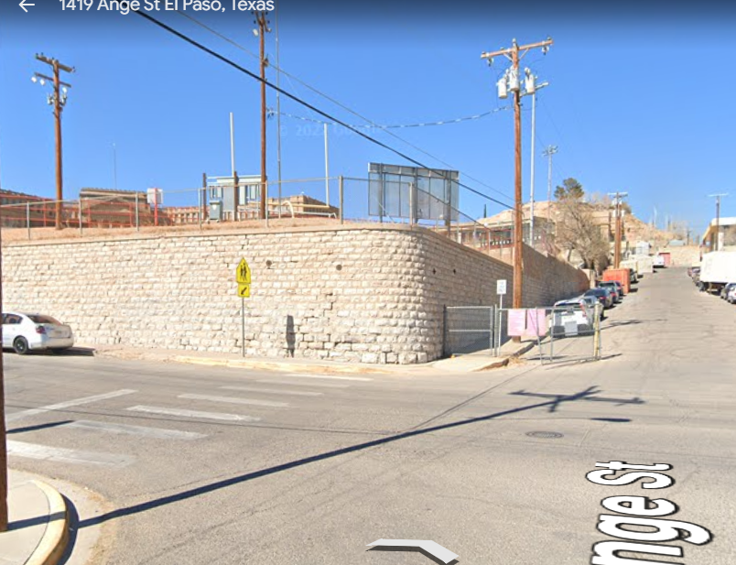
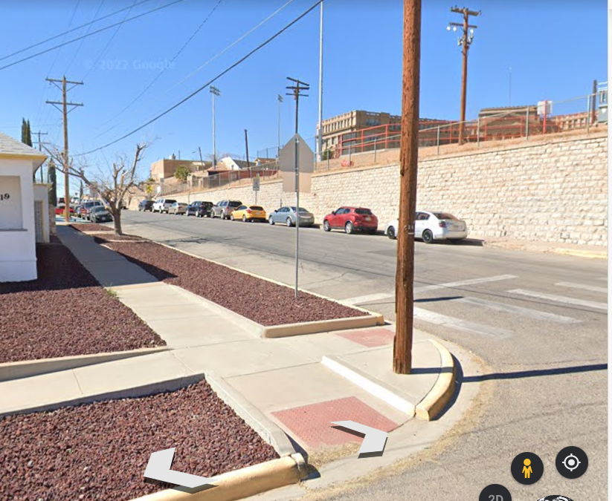
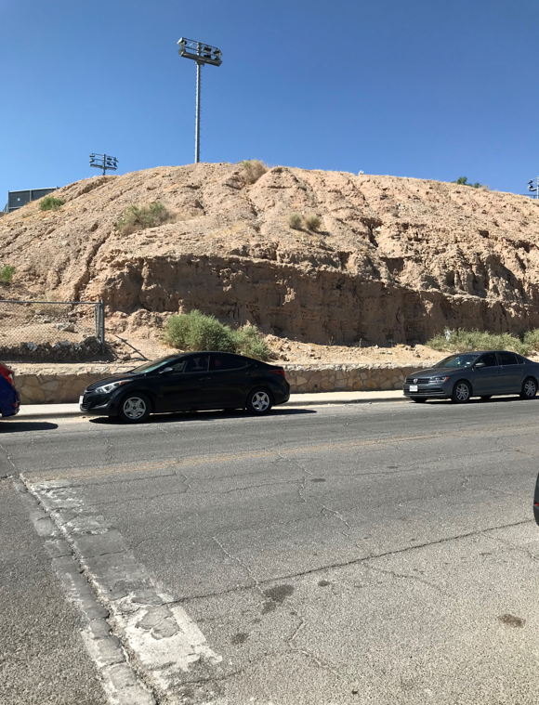
Drone Pilot’s view in direction helicopter approached from
Notice this hill up here. The drone pilot did not fly from there
Helicopter path
Drone pilot’s subject was not directly visible from their position. They had to rely on the drone’s camera to see their subject

Slide 8
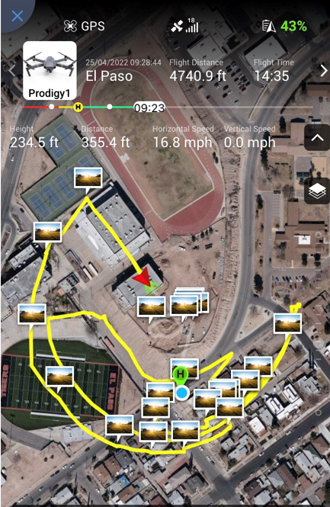
The drone flight path prior to the Near Mid Air Collision
Yellow line shows the drone’s flight path
Notice the drone’s height (altitude in AGL)
Notice how far the drone is away from the ground control station (the Remote Pilot’s location)
Notice the drone’s speed
Notice how long the drone was airborne and how much battery life is left
Q: Do you think the Remote Pilot performed continuous see-and-avoid duties during this flight, or do you think they may have been distracted by “screen watching”, looking for the ideal camera shot?
Helo
Remote Pilot’s location

Slide 9


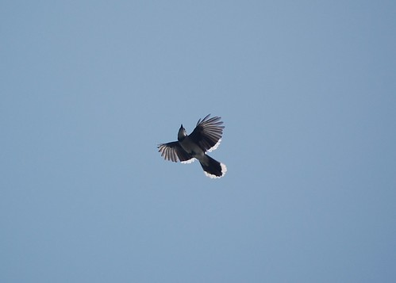
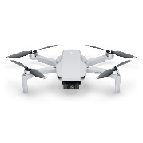
Relative Size
Q: How likely (and how far away) will the two pilots see each other, especially in overcast or bright sunlight conditions, when the manned aircraft is flying at 100+ knots?
Q: Will they have time to safely maneuver away?
Blue Jay
Small Drone

Slide 10
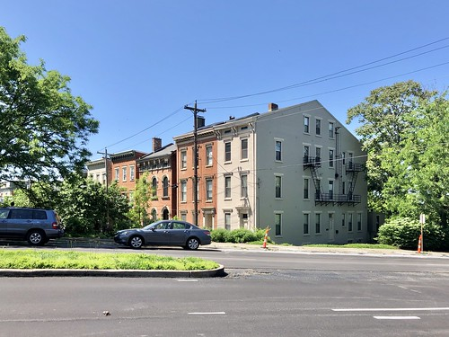
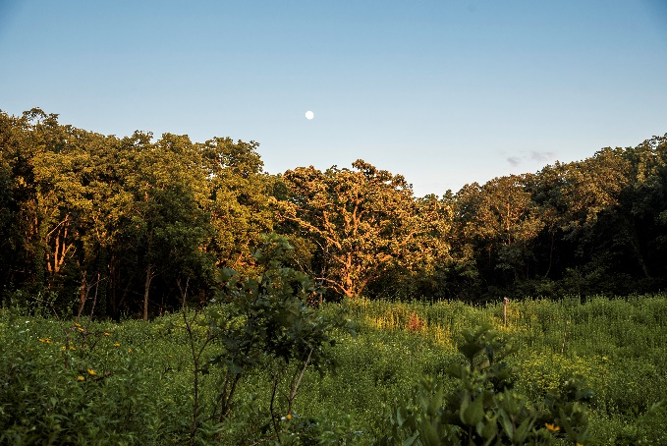

Studies show it takes the average (undistracted) pilot 12.5 seconds to detect another aircraft, decide, and act. That’s ½ mile at 100 knots ground speed
  How many seconds would a drone pilot have to react to a low flying aircraft approaching from behind those obstructions in the pictures below at 100 knots (186 feet per second) groundspeed?
  How close will the other aircraft be when the drone pilot finally sees it?
  How would “screen watching” impact the time it takes the drone pilot to detect, decide, and act?
2
3
2
1
3

Slide 11

Screen Watching vs “See and Avoid”
The primary responsibility of a drone pilot is to see and avoid other aircraft, persons, and property
Many drone pilots “screen watch” and don’t “airspace watch”
  Q: Are they a camera operator or a pilot?
  A: They are a pilot and accountable (and need to stop screen watching or get one or more Visual Observers to observe the airspace)
Studies show that on average, it takes 12.5 seconds for a pilot to react to another aircraft. A helicopter traveling at 100 Knots ground speed covers ½ mile in those 12.5 seconds. Can we see at least ½ mile down to the horizon in all directions when we fly our drone? Does screen watching increase that reaction time?
Notes:
Key message: A pilot’s primary responsibility is to see and avoid other aircraft, at any altitude, from any direction.
We’ve noticed that many drone pilots tend to do a lot of “screen watching” looking for that ideal camera angle, or heavily relying on telemetry to tell the drone pilot where their drone is. Screen watching is a major distraction from the primary responsibility of watching the airspace. If you plan to do any screen watching, realize that this increases your reaction time, and increases the distance an encroaching aircraft can appear in your vicinity, and get one or more visual observers to help you clear the airspace.
Site location is an often overlooked planning consideration. Is there a spot nearby that is better suited to position the UAS team where they can see more of the airspace and still get the video needed?
Consider using a team of a drone pilot, a VO, and a camera operator to get those photos or videos.
Key message: It is the pilot’s responsibility to keep the drone from being a hazard to persons or property in the air or ground.
Consider discussing 18 USC 39b which is a DOJ enforced reg, and could lead to criminal charges, jail time, and fines for any drone pilot that puts a manned aircraft at risk

Slide 12
Visual Line of Sight 14 CFR Part 107
§ 107.31 Visual line of sight aircraft operation
(a) With vision that is unaided by any device other than corrective lenses, the remote pilot in command (RPIC), the visual observer (if one is used), and the person manipulating the flight control of the small unmanned aircraft system must be able to see the unmanned aircraft throughout the entire flight in order to:
(1) Know the unmanned aircraft's location;
(2) Determine the unmanned aircraft's attitude, altitude, and direction of flight;
(3) Observe the airspace for other air traffic or hazards; and
(4) Determine that the unmanned aircraft does not endanger the life or property of another
It’s not just about seeing the drone....
(a) means that with only their eyes, the RPIC needs to be in a position to be able to see the drone and the surrounding airspace well enough to avoid a collision during the entire flight. This also means the VLOS requirement applies to the RPIC even if using a VO

Slide 13
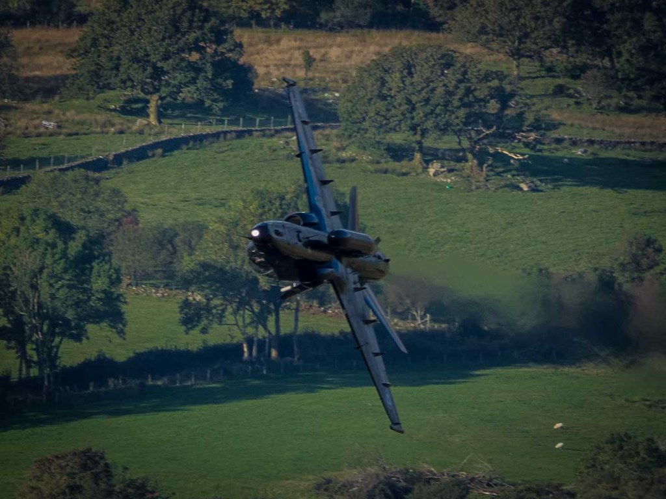
See And Avoid 14 CFR Part 107
§ 107.37 Operation near aircraft; right-of-way rules
Each small unmanned aircraft must yield the right of way to all aircraft, airborne vehicles, and launch and reentry vehicles. Yielding the right of way means that the small unmanned aircraft must give way to the aircraft or vehicle and may not pass over, under, or ahead of it unless well clear
(b) No person may operate a small unmanned aircraft so close to another aircraft as to create a collision hazard

Slide 14

See and Avoid 14 CFR Part 91
§91.111 Operating near other aircraft
(a) No person may operate an aircraft so close to another aircraft as to create a collision hazard
§91.113 Right-of-way rules: Except water operations
(b) General. When weather conditions permit, regardless of whether an operation is conducted under instrument flight rules or visual flight rules, vigilance shall be maintained by each person operating an aircraft so as to see and avoid other aircraft. When a rule of this section gives another aircraft the right-of-way, the pilot shall give way to that aircraft and may not pass over, under, or ahead of it unless well clear
Public Aircraft Operators and Civil drones weighing more than 55 pounds fly under 14 CFR Part 91

Slide 15
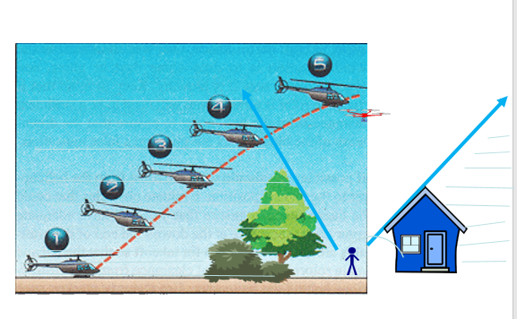
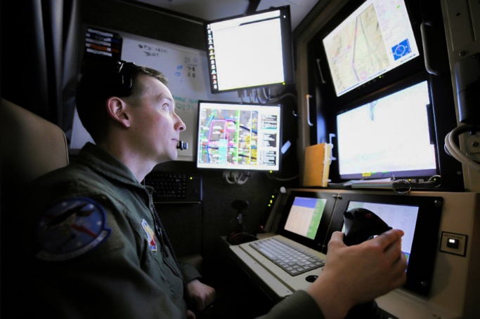
Are these drone pilots complying with Visual Line of Sight (VLOS) rules without a waiver?
They are not in compliance (without a waiver). They cannot “see and avoid” from their location
Notice this drone pilot has a very limited view of the airspace
Notes:
The operator on the left is inside a structure, and unable to look up and see the drone with unaided vision. This operation needs a waiver or exemption to operate in this manner. Having VOs outside does not relieve him from that responsibility.
The operator on the right is not able to see enough of the surrounding airspace to allow time to detect and react to the low flying helicopter in this picture. The operator must be able to see enough of the surrounding airspace at all times during the flight, to ensure the drone doesn’t become a hazard to other aircraft or persons and property on the ground. Since helicopters, ultralights, parasails, and agricultural aircraft can operate from the surface and up, vigilance must be maintained by the Remote Pilot to see them from the surface and up, and see them far enough out to safely react and maneuver out of their way.
Discussion Opportunity: How might the operator on the right modify their operation to minimize risk of a collision? What could the operator do to make their drone more visible to manned traffic? What height should the drone operator stay under to minimize risk of a collision if they can’t see down to the horizon in all directions? Can a waiver be obtained to do this operation? How does one go about obtaining a waiver? How many feet per second does a helicopter flying at 100 Knots ground speed cover over the ground? ANS: 186 feet/second

Slide 16
More About Drones and Helicopters
Drones are not allowed to transmit ADS-B Out (some rare exceptions exist, however)
Drone pilots are not allowed to transmit on aviation spectrum (some rare exceptions exist, however)
Small drones do not have “detect and avoid” systems
Drones operate on home wifi spectrum and are susceptible to jamming and/or interference
Drones are required to give way at all times to other aircraft
Visual illusions and relative position pose a unique challenge to drone operations because the pilot is not aboard the drone
Helicopters (and Ag Aircraft, Seaplanes, Ultralight Vehicles, and Hot Air Balloons) can legally operate below 500 feet, and often do
ADS-B Out is line-of-sight, and many traditional (manned) aircraft are not equipped
Collisions and NMACs have occurred in rural and urban settings, day and night, above and below 400 feet

Slide 17

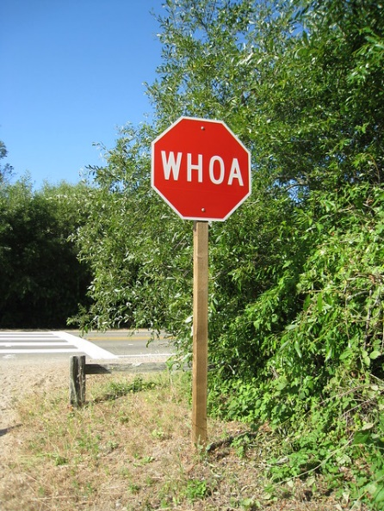
Common Investigatory Findings
Interviews of the drone pilots during these investigations revealed that ALL of these drone pilots involved in the collisions and this Near Mid Air Collision case study (were):
  Heads down (screen watching),
  Not watching the surrounding airspace,
  Did not consider the possibility of the presence of a low flying, fast moving aircraft in their pre-mission planning, and
  Surprised by the sudden appearance of the other aircraft

Slide 18
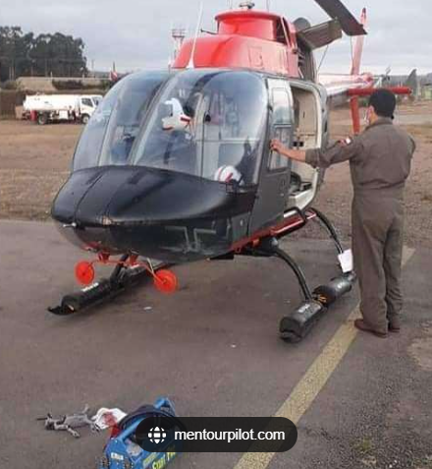
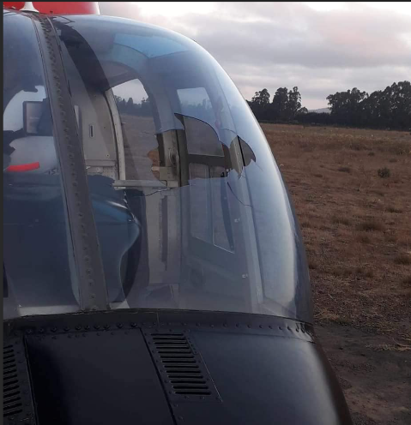
Safety Message to Drone Pilots
Perform pre-mission planning to identify high risk areas such as hospital helipads, utility lines, agricultural areas, etc.
Stay as low as possible
  As close to the obstruction as safely possible
Use anti-collision lights and bright colors to help others see and avoid your drone
Expect other aircraft to be everywhere and at very low altitudes, even below 400 feet!
See and avoid other aircraft
This happened in Chile at 800 ft AGL
That drone weighed only 20 oz

Slide 19
Safety Message to Manned Pilots
Get above 400 ft over the highest obstruction ASAP
Wear eye protection
Expect drones to be everywhere
Mentor local drone flying organizations (media, real estate, public safety) to educate them about aviation risk, and create awareness of your operation
This happened in Chile at 800 ft AGL
That drone weighed only 20 oz

Slide 20
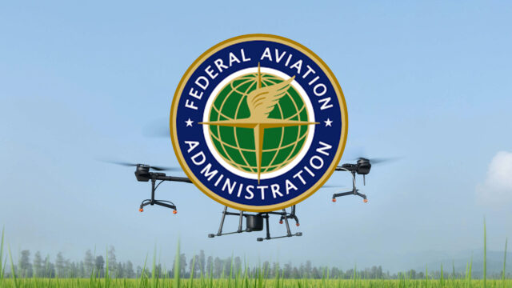
Message to Manned Pilots (cont.)
Identify and coordinate with local entities that have drone detection equipment prior to and during the flight (for actionable alerts)
  Have your dispatch check with them before flight
Partner with the FAASafety team to mentor and educate new aviators

Slide 21
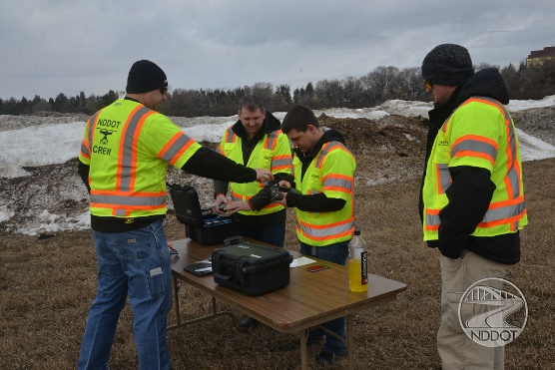
Drone Pre-Mission Planning Best Practices
Conduct a ground and air risk assessment
  Site selection matters
  Identify an operating location that minimizes risk
    Can you see in all directions down to the horizon and out at least ½ mile? If not, have a plan and mitigate the risk
Clarify before flight
  Who is the pilot? Who is the camera operator? Who are the VOs, and what are their assigned airspace sectors of observation?
  Do you have the required FAA airspace authorizations and waivers?
  Which flight rules apply? (Part 107 or Part 91)
  Flyaway procedures
  Lost link procedures
  Collision avoidance procedures
Use multiple VOs whenever possible

Slide 22
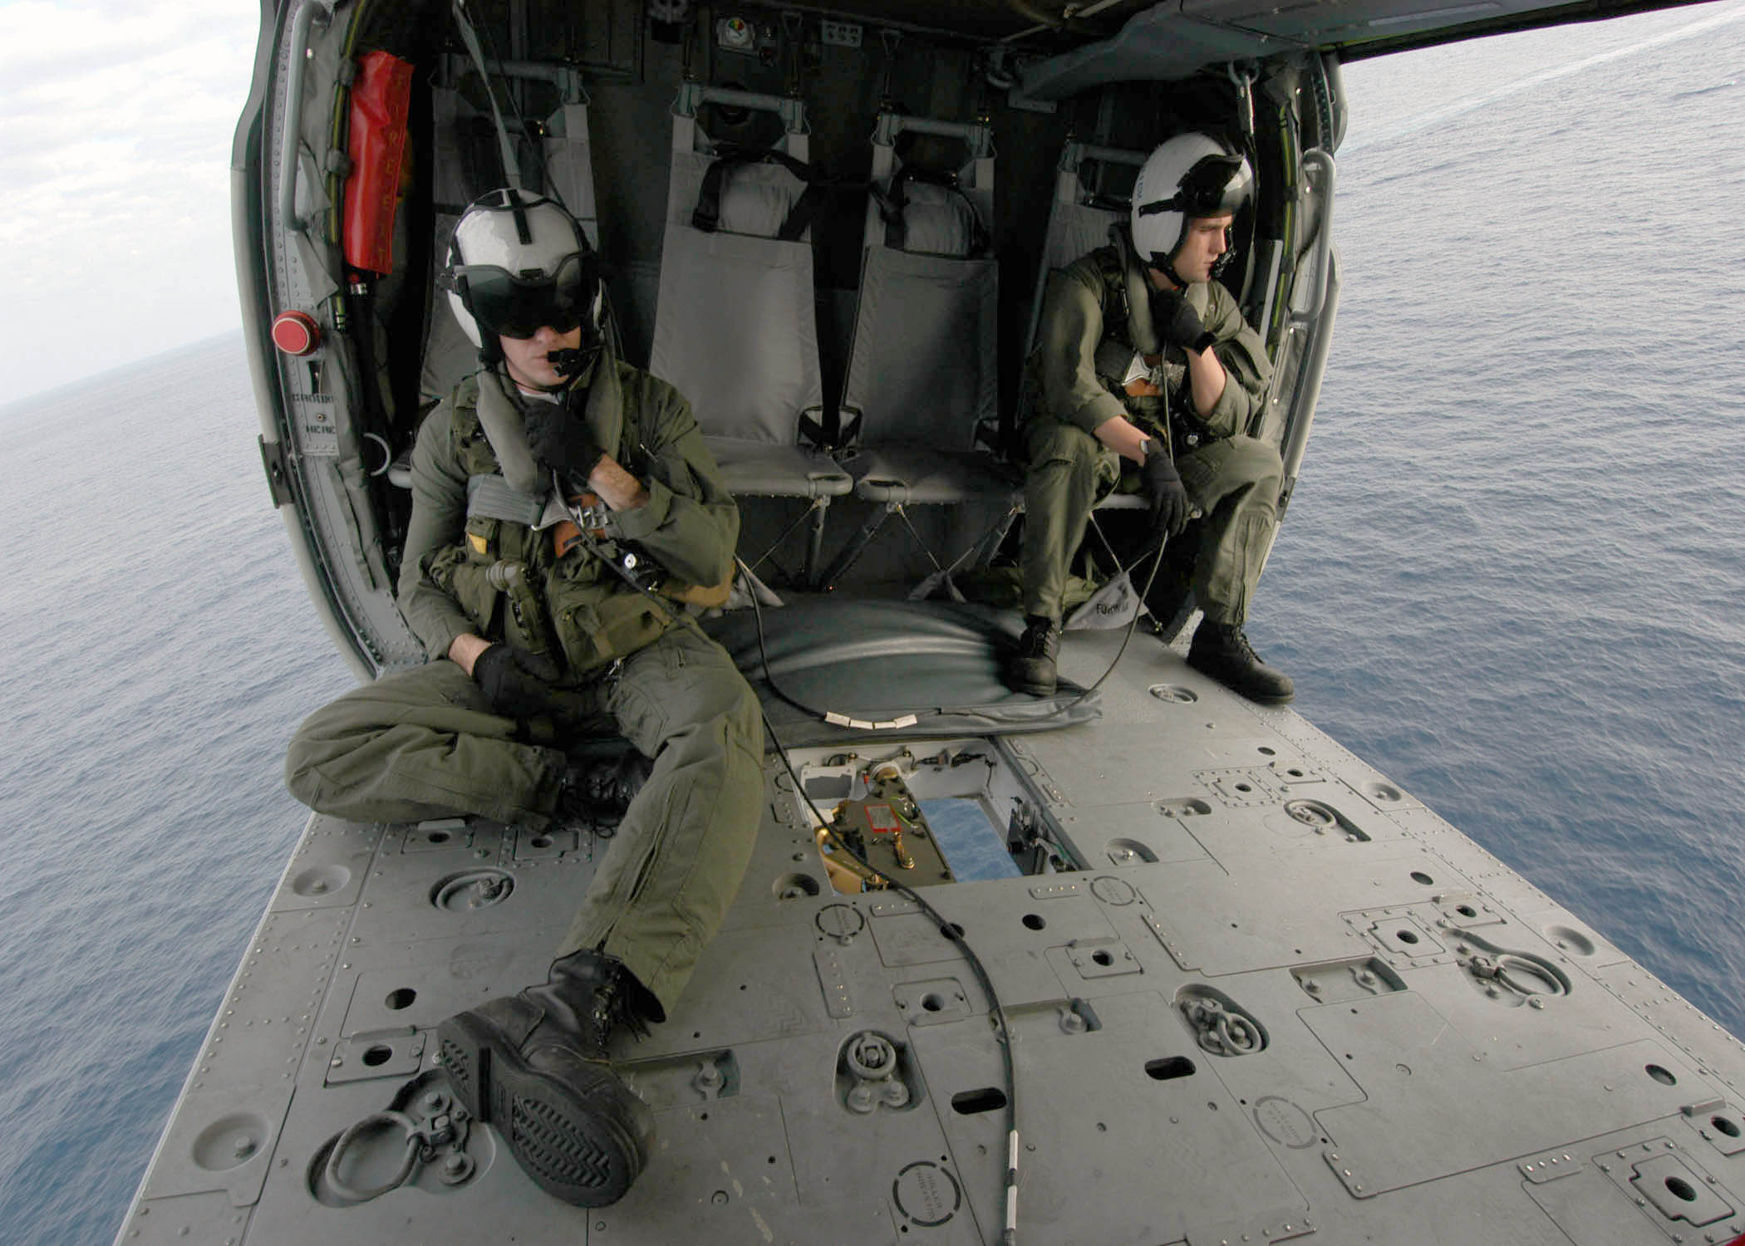
Working with UAS in Emergencies
Drones and manned aircraft are complementary assets
  Drones can go where manned aircraft ought not
  There are usually more drone teams available than manned aircraft
  Drones are good at locating people but can’t deliver/retrieve heavy objects
  Drones have limited range
Get reps from all aviation assets together for briefings
  Pre-coordinate
  Follow the playbook
  Maintain altitude discipline
Drones and manned aircraft are complementary assets
Leverage their unique strengths

Slide 23

Handy Tools and References
www.faa.gov/uas
Airport (heliport) Data and Information Portal (ADIP): https://adip.faa.gov/agis/public/#/airportSearch/advanced
Emergency Waivers and Authorizations: https://www.faa.gov/uas/advanced_operations/emergency_situations
FAA Advisory Circulars https://www.faa.gov/regulations_policies/advisory_circulars/
  107-2A Small Unmanned Aircraft System (Part 107)
  91-63D Temporary Flight Restrictions
  00-1.1B Public Aircraft Operations
  90-48E Pilot’s Role in Collision Avoidance
  60-22 Aeronautical Decision Making
  120-68J Pilot Records Database
  137-1B Agricultural Aircraft Operations
FAA Law Enforcement Assistance Program leap@faa.gov
FAA Public Safety Toolkit: https://www.faa.gov/uas/public_safety_gov/public_safety_toolkit

Slide 24

Questions About Drone Flying?
Reach out to the FAA UAS Support Center
  uashelp@faa.gov
  844-FLY-MYUA (844-359-6982)
  Public safety persons should identify themselves and the UAS Support Center will connect you with the FAA UAS public safety team

